Slide 1

MODY UNIVERSITY OF SCIENCE AND TECHNOLOGY
SCHOOL OF ENGINEERING AND TECHNOLOGY

Slide 2

REAL TIME OBJECT DETECTION
AND IDENTIFICATION
TEAM MEMBERS
MENTOR
MENTOR
Neetu
200373
Dr. Sanjeev Patwa
Ritika Rathi
200381

Slide 3
CONTENTS
INTRODUCTION
RELEVANCE AND FEASIBILITY
METHODOLOGY
PROPOSED STANDARDS
PROJECT DESIGN
MAINTAINABILITY
REALSTIC CONSTRAINTS
GANTT CHART
PRIVACY AND SECURITY
CONTRIBUTION TO THE SOCIETY
FUTURE WORK

Slide 4
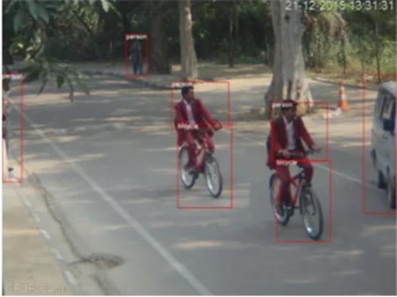
INTRODUCTION
THIS PROJECT AIMS TO DO REAL-TIME OBJECT DETECTION THROUGH A LAPTOP CAMERA OR WEBCAM USING OPENCV AND MOBILENETSSD.
FIGURE-01: DETECTION AND CLASSIFICATION OF OBJECTS
MOTIVATION- RECOGNITION, TRACKING , ETC.

Slide 5
RELEVANCE & FEASIBILITY
RELEVANCE
BEHAVIORAL FEASIBILITY
The main goal of object detection is to scan digital images or real-life scenarios to locate instances of every object, separate them, and analyze their necessary features for real-time predictions.
The system will require simple desktop computers. The system is very user friendly so that any layman who has computer knowledge can use it. This makes the behavior doable.
OPERATIONAL FEASIBILITY
TECHNICAL FEASIBILITY
The operational feasibility of the system lies in the fact that it is user-friendly, easy to use and has a simple user interface. The proposed system worked successfully, achieving the intended functions and resulting in consistent performance and improved performance.
In a technical feasibility study, it is to be tested whether the proposed system can be developed using the existing technology or not. It is planned to use the proposed system using Python, OpenCV, Keras, Tensorflow.

Slide 6


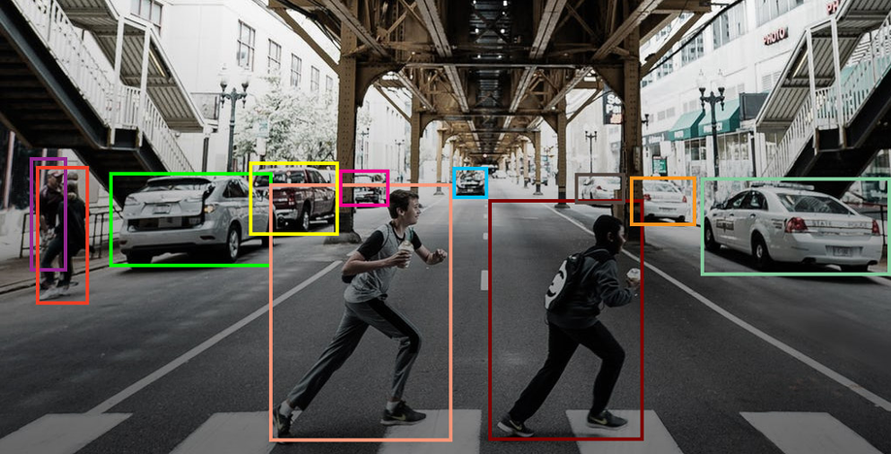
METHODOLOGY
STEP-1
Divide every 32*32 px images into patches.
STEP-2
Values obtained above will represent final feature vector for images
STEP-3
Classification using CNN Architectures.
STEP-4
Different Models will be compared based on model accuracy and validation
accuracy and respective losses, with activation function SoftMax.

Slide 7
TECHNOLOGIES USED
TOOLS : ANACONDA , JUPYTER NOTEBOOK
LANGUAGES: PYTHON
CONCEPTS: SSD MOBILENETV3 (SINGLE SHOT DETECTION)
LIBRARIES: TENSORFLOW, OPEN CV, MATPLOTLIB.PYPLOT

Slide 8
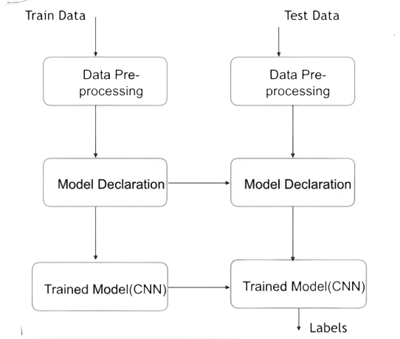
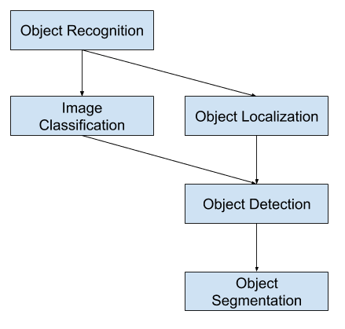
PROPOSED STANDARDS
Block Diagram
Flow Chart

Slide 9
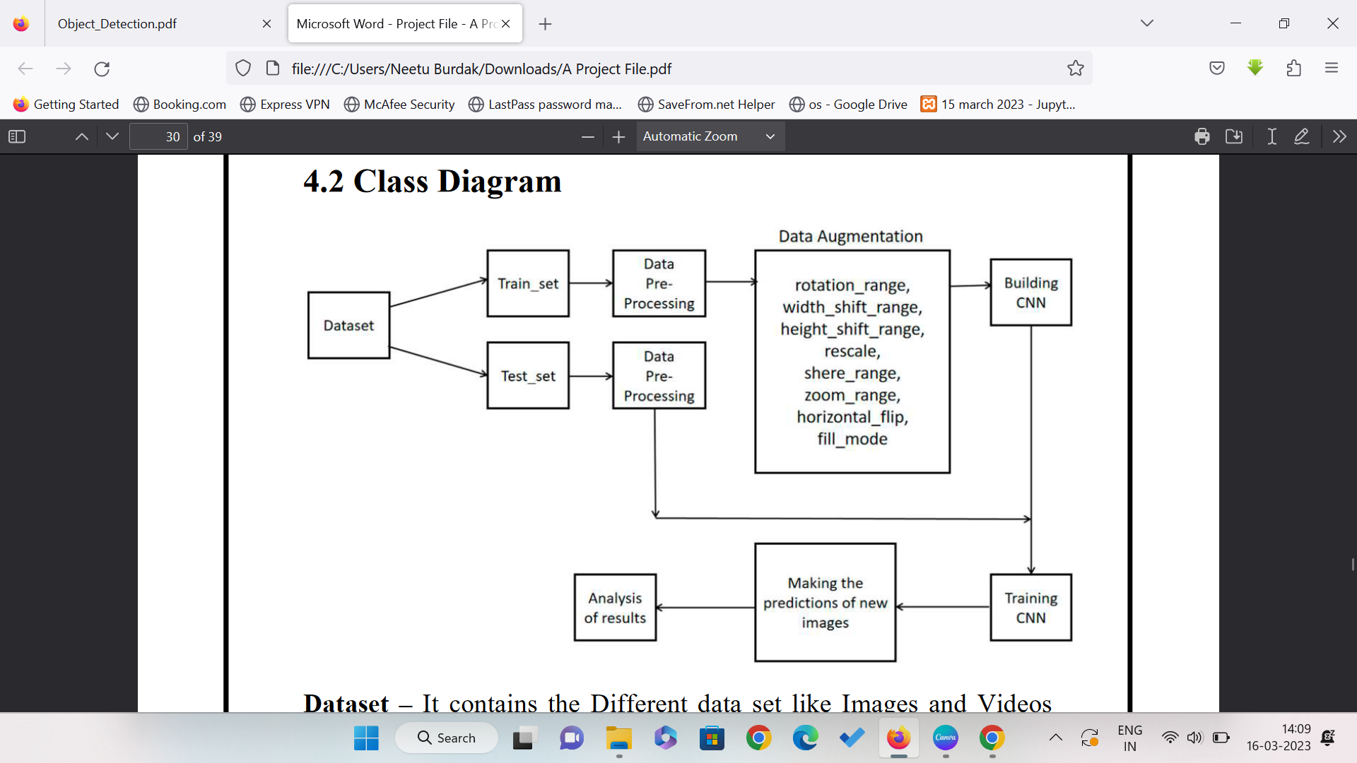
PROJECT DESIGN

Slide 10
DATASET – IT CONTAINS THE DIFFERENT DATA SET LIKE IMAGES AND VIDEOS
ABOUT THE OBJECTS WHICH NEED TO DETECT AND HELPS TO TRAIN THE SYSTEM TO
DETECT THE CUSTOM OBJECT.
TRAIN_SET – TRAIN_SET ARE THE SET OF DATA WHICH IS COLLECTED FOR TO TRAIN
THE MACHINE TO DETECT THE CUSTOM OBJECT.
DATA PRE-PROCESSING – NOW THE TRAIN_SET WILL BE IN PROCESSING TO TRAIN
THE SYSTEM TO DETECT A CUSTOM OBJECT WITH THE HELP OF DATA PRE-
PROCESSING.
BUILDING CNN – CNN IS A TRAIN DATA SETS ABOUT THE DATA PRE-PROCESSING
WHICH WILL BE EXECUTED TO DETECT THE CUSTOM OBJECT.
TRAINING CNN – THIS FILE CONTAINS THE PROCESSED DATA SET AND THE PRE-
PROCESSING DATA.
ANALYSIS OF RESULT – WITH THE HELP OF BUILDING CNN AND TRAINING CNN
WE CAN DETECT THE CUSTOM OBJECT FOR WHICH OUR SYSTEM IS TRAINED.

Slide 11
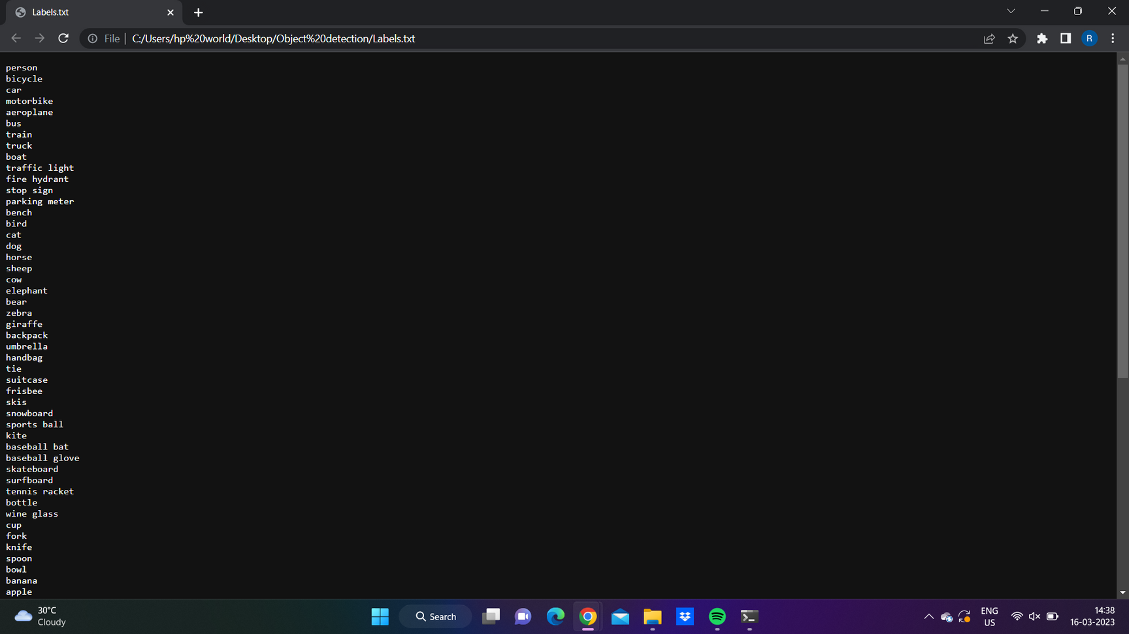
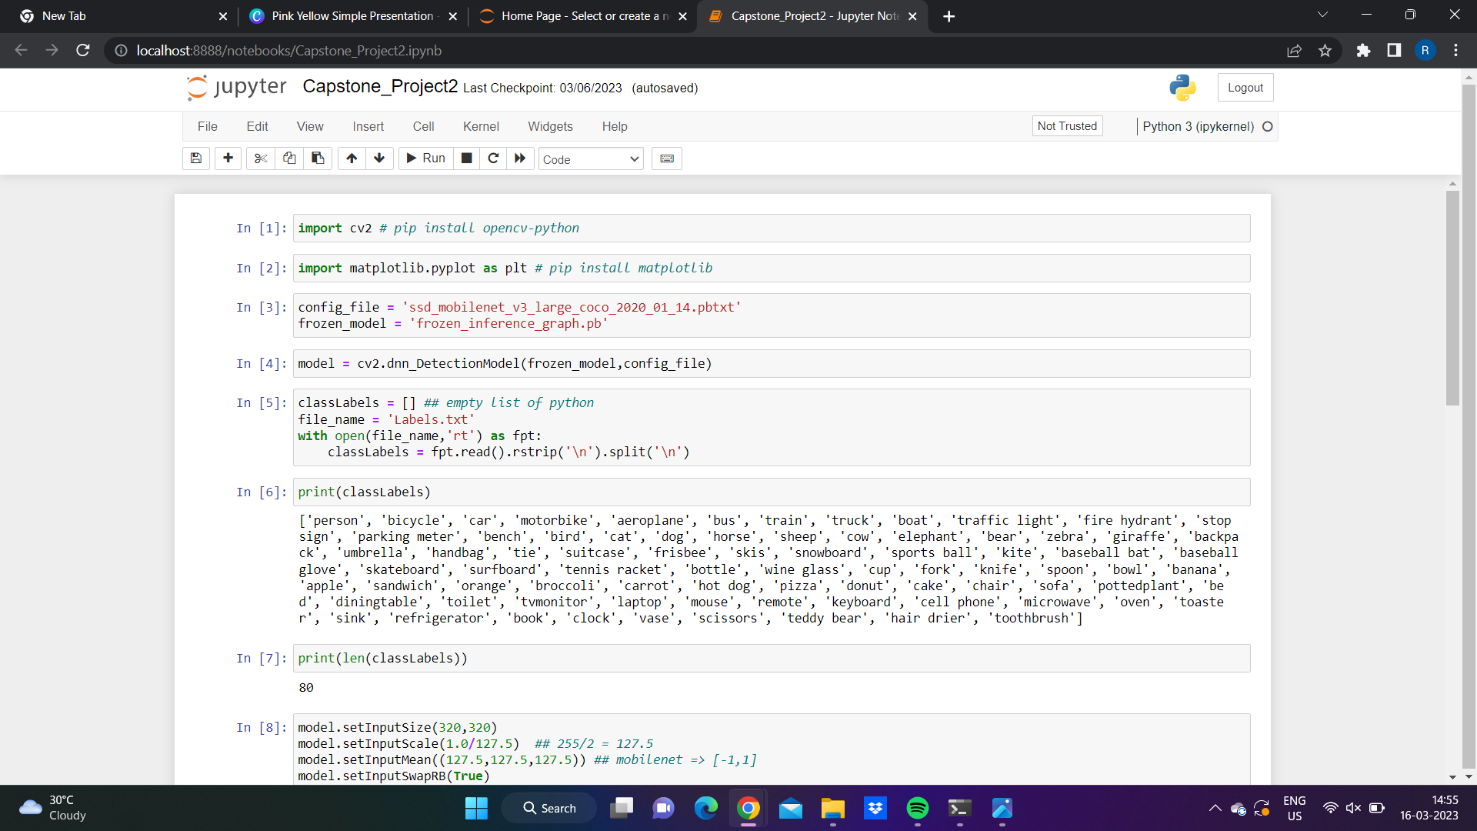
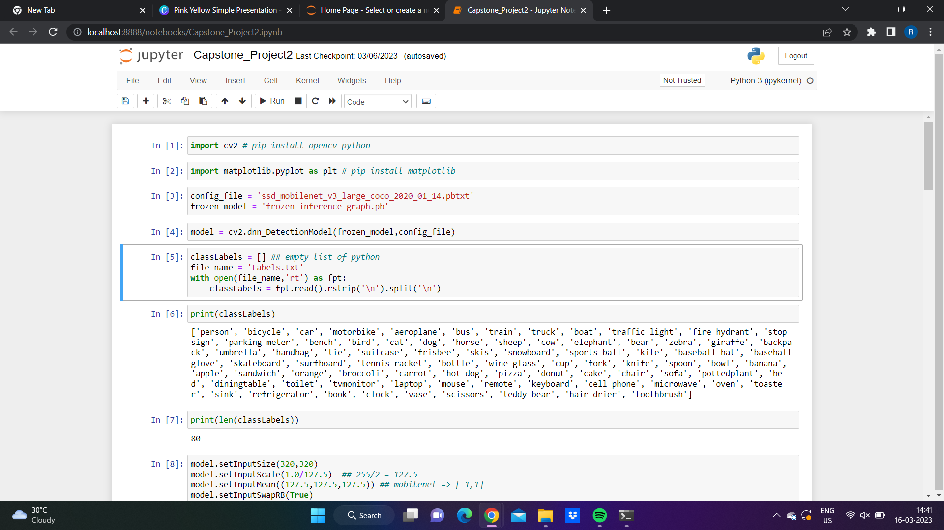
Creating the labels text file for some basic objects.
Importing of libraries
Printing the labels file in jupyter notebook.

Slide 12

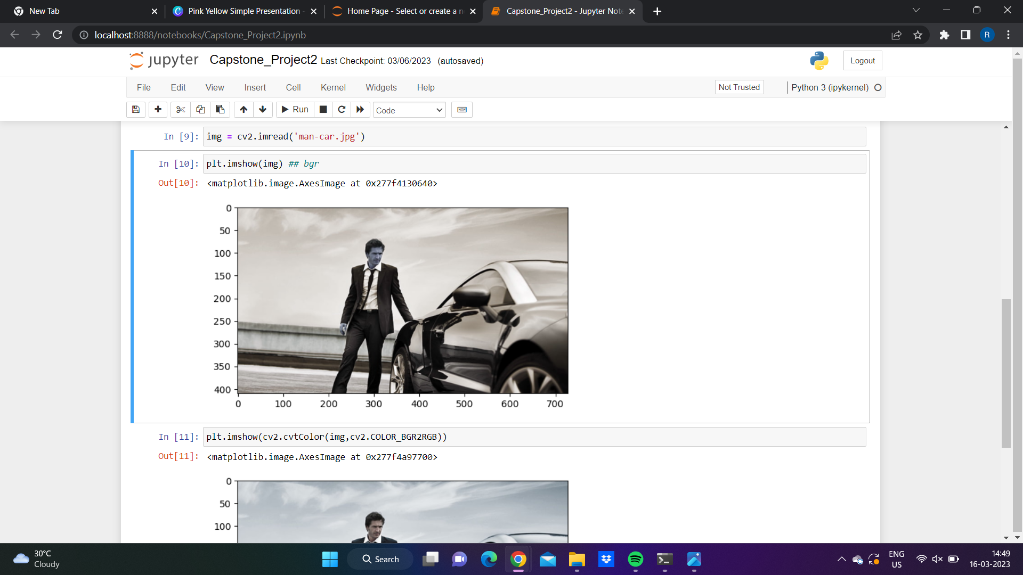
Using random image to upload.
Plotting of image on axis.

Slide 13
MAINTAINABILITY
THERE ARE DIFFERENT SOLUTIONS BY WHICH WE CAN MAINTAIN PERFORMANCE OF YOUR OBJECT DETECTION MODEL LIKE IMPROVING DATA SET WITH THE HELP OF IMAGE AUGMENTATION, PSEUDO LABELING, ENSEMBLING ETC.
FULLY CLOSED OBJECT CANNOT BE TRACKED AND CONSIDERED AS A NEW OBJECT IN THE NEXT FRAME

Slide 14
REALISTIC CONSTRAINTS
RELIABILITY
This platform is reliable because we make prompt changes whenever necessary.
Usability
This is a user friendly Platform and have a easy user experience using camera.
Availability
To access our platform it needs a stable internet connection along with a system or any device along with any web browser and camera.
Durability
Our project is for long-time and also will get updated time to time making it compatible with all devices.

Slide 15
SECURITY & PRIVACY
CUSTOM OBJECT DETECTION
Every object is detected, and later you can custom object. By this detection, the visual can be detected and defined, giving more personalized and custom purposes.
User Verification
Suppose someone is looking for minor details for verification. In that case, object recognition makes it more accessible, and it makes everything on the spot and helps save time on the long going process.
Personalization
Object Recognition provides personalization in facial practices like image, video, and much more. It lets users/customers search instantly based on the visual.
Highly Reliable Resource
It is a highly reliable resource because whatever object is recognized can be verified. The software helps you to cross-check and only go further with permission. If it is not the same, then it can be modified in real-time.
Simpler And Faster Process
To perform Object Recognition does not take much time and provides efficient results. It is a simple and faster process, and most of all, it is done in real-time. The service takes less effort and brings a quick, accurate outcome.

Slide 16
CONTRIBUTION TO SOCIETY
THIS PROJECT HELPS IN CONTRIBUTION TO THE SOCIETY INCLUDING VIDEO SURVEILLANCE, ACTIVITY RECOGNITION, ROAD CONDITION MONITORING, AIRPORT SAFETY, MONITORING OF PROTECTION ALONG SEA BORDERS, ETC., HAVE MADE USE OF MOVING OBJECT DETECTION. THIS TECHNOLOGY HAS THE ABILITY TO RECOGNISE AND TRACK THINGS IN PICTURES AND VIDEOS. OBJECT DETECTION, COMMONLY REFERRED TO AS OBJECT RECOGNITION,HAS SEVERAL USES INCLUDING SECURITY SYSTEMS, SELF-DRIVING CARS, PEDESTRIAN COUNTING, VEHICLE RECOGNITION, AND A LOT MORE.

Slide 17
FUTURE WORK
IMPLEMENTING THIS AS A WEB APPLICATION.
To set data more accurate and more data training.
PARTICULARLY CAN BE USED IN BANKS TO AVOID ROBBERY.
ALSO WILL PRODUCE THE SOUND ON SEEING PARTICULAR THINGS LIKE WEAPONS.

Slide 18
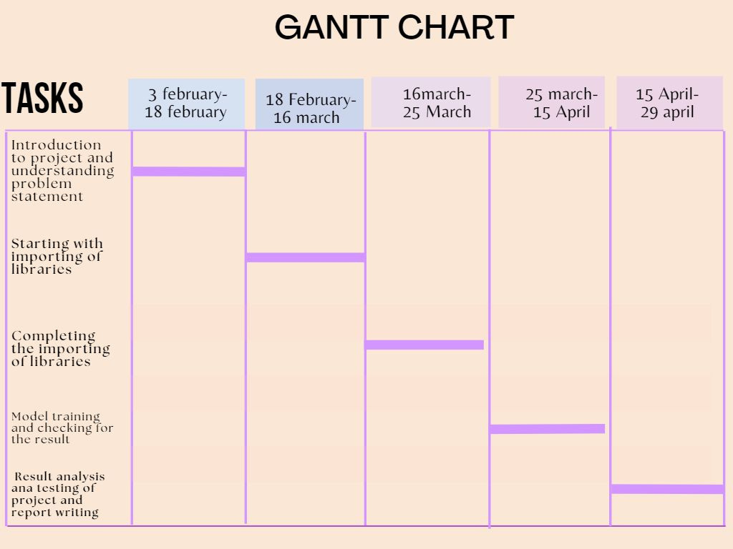
GANTT CHART

Slide 19


Thankyou

